Slide 1
Please Read
This PowerPoint presentation needs to be viewed in "Slide Show" view, because it contains effects, animations and interactions.
If a presenter elects to view it in "Normal" view, some slides will display with layers of text and/or graphics and may not be legible.
Notes:
Please Read

Slide 2
Developed with the generous support of The
SCAN Foundation
Our Mission
To prevent and relieve suffering and promote quality of life, at every stage of life, through patient and family care, education, research and advocacy.
Learn more at www.palliativemed.org
Project Lead
Paula McMenamin, MSW
Content Experts
Connie Carr, CNP
Frank Ferris, MD Paula McMenamin, MSW
JJ Nadicksbernd, MSW
Patricia Strunk, RN MSN
Instructional Designers
Barbara Greenstein, MA
Kendra Haddock, MA
Lisa Wortman, MA
Narration
Jessica Barr, BS

Slide 3
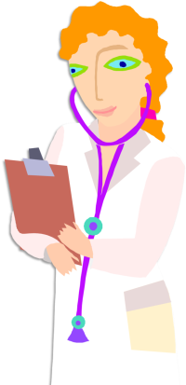
Care at the End of Life
Module 1 Managing Resident Care
Module 2 Preparing the Family
Module 3 After Death
IMPORTANT: Every state has different laws regulating LTC, and it is your responsibility to know your specific job duties. The content presented in this course is comprehensive and not tailored to meet the specific needs of LTC professionals in any one state. If you are unsure how it applies to you, ask your supervisor.

Slide 4
Module One Managing Resident Care
Bite 1: Environmental Control
Bite 2: Signs and Symptoms of Dying
Bite 3: Giving Comfort
Bite 4: Foods and Fluids

Slide 5
Environmental Control
Module One | Bite 1
Notes:
Environmental Control
Module 1, Bite 1

Slide 6
At the end of Bite 1 you will be able to:
Identify the definition of a “Good Death”
Identify characteristics of a “Good Death”
Identify characteristics of a “Bad Death”
Identify actions care providers can take to help residents have a “Good Death.”

Slide 7
Reflect On It
Have you ever been present when someone died?
What was that experience like for you?
Did you feel the resident was comfortable when they died?

Slide 8
“A good death is whatever the resident and family says it is...”
What is a good death?
Having a plan in place so my wishes are honored
Controlling symptoms to my satisfaction
Having family present
Being free from anxiety
Being free from pain
Having my final arrangements made

Slide 9
Reflect On It
Have you been present at a bad death?
What was the experience like for you?
Did you feel the person was at peace when they died?

Slide 10
“A Bad Death is whatever the resident says it is...”
What is a bad death?
The resident’s last wishes were not honored
The death was not peaceful
Survivors were left with lingering regrets or feeling bad
The death caused divisions in the family

Slide 11
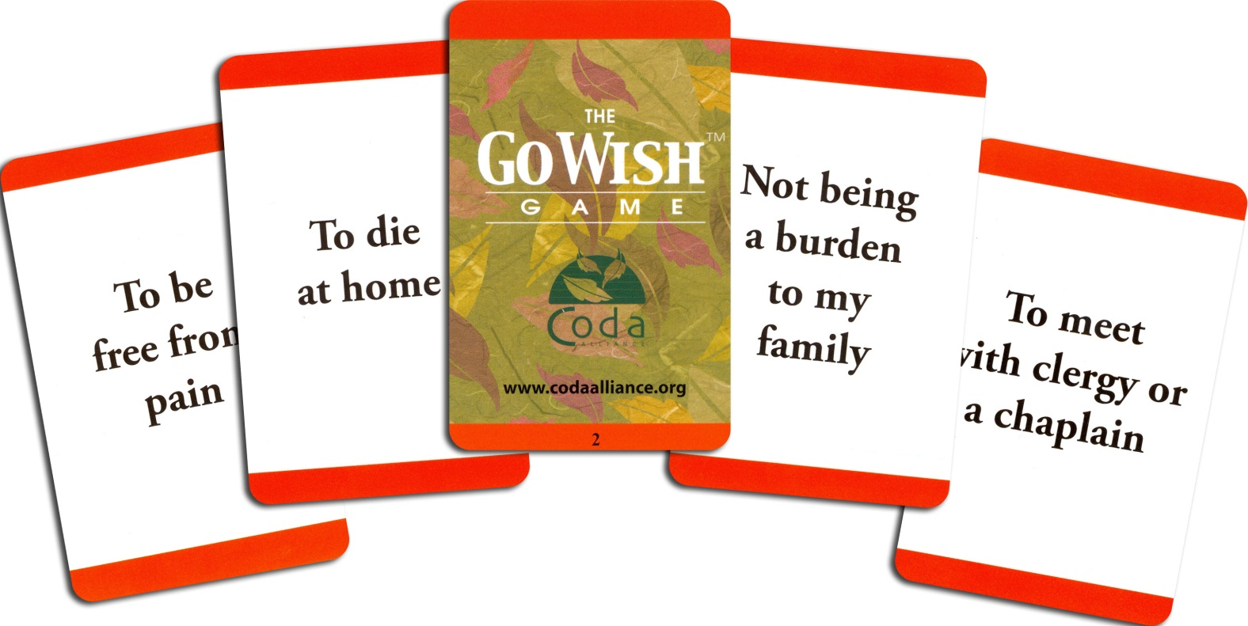
Go Wish Cards
Use “Go Wish” cards to encourage conversations about end-of-life wishes.
Learn more about the Go Wish Cards and purchase at palliativemed.org/store
Notes:
What can you do to help your resident's have a Good Death?
You can use the “Go Wish” cards to encourage discussion about end-of-life wishes.
Go wish cards give residents and their families an easy and open forum to talk about what's important at the end of life.
They contain examples of common end of life wishes, such as:
“To be free from pain”
“To die at home”
“Not being a burden to my family”
“To meet with clergy or a chaplain”
Click on the hyperlink to learn how you can purchase these cards

Slide 12
What you can do
Review POLST
Observe and report changes in condition
Be a source of comfort & support
Facilitate family care conferences
Facilitate communication between the family and hospice team
Notes:
There are other things you can do to help your residents have a good death and be a source of comfort and support for your them and their family.
Review residents' Physician Orders for Life-Sustaining Treatment (POLST) so that you can support and reinforce those wishes with members of the resident's family.
Facilitate family care conferences to discuss end of life care goals and the resident's expressed wishes.
Facilitate communication between the resident's family and the Hospice care team.
Observe and report changes in condition of the resident to the Hospice Care team. Hospice will manage the resident's symptoms so that the resident is comfortable.

Slide 13
Case Story #1
Mr. Sanford is a 67 year old male with a diagnosis of dementia. His wife passed away several years earlier. He has 2 sons who all live out of the area, but call to check on him regularly and visit once a year. Mr. Sanford has not informed anyone of his end-of-life wishes and is now unable to because of his dementia. As Mr. Sanford nears death, he has stopped eating, drinking, and is having difficulty breathing as a result of pneumonia. One son requested that he be transported to a hospital, where a feeding tube was placed. When the second son found out about this, he requested the feeding tube be removed, but not until he had a chance to visit his father. Mr. Sanford died in the hospital shortly before his son arrived.

Slide 14
Case Story #1
Did Mr. Sanford have a good death?
Why did he not have a good death?
What could have been done differently?

Slide 15
Comfort Care
Module One | Bite 2
Notes:
Comfort Care
Module 1, Bite 2

Slide 16
At the end of Bite 2 you will be able to
Identify the stages of dying
Identify the symptoms of dying
Describe the symptoms of dying

Slide 17
Actively Dying
Dying process is taking place.
Symptoms last days or hours.
Imminent Death
Death is about to occur.
Symptoms last minutes or seconds.
Death

Slide 18
Social Withdrawal
Physical Changes
Actively Dying
Decreased Intake
Imminent Death
Incontinence
Increased Sleep
Decreased Senses
Disorientation
Restlessness

Slide 19
Symptoms of Death
Social Withdrawal
Decreased Intake
Increased Sleep
Disorientation
Restlessness
Decreased Senses
Incontinence
Physical Changes

Slide 20
Case Story #2
Mrs. Garcia is a 92 year-old female with a diagnosis of congestive heart failure. Her appetite has been steadily decreasing over the last few months. She recently lost her ability to walk and is now wheelchair-bound. Mrs. Garcia becomes very short of breath with any activity. Two days ago, she was unable to sit up and appeared very weak. When being fed, she holds the food in her mouth but does not chew or swallow. Mrs. Garcia is very lethargic and sleeps most of the day, but can still be awakened for brief periods.

Slide 21
Case Story #2
What are 3 signs that Mrs. Garcia is transitioning toward death?
How close do you think Mrs. Garcia is to dying, days or hours?
What advice can you give to the family to deal with Mrs. Garcia's sleepiness?

Slide 22
Giving Comfort
Module One | Bite 3
Notes:
Giving Comfort
Module 1, Bite 3

Slide 23
At the end of Bite 3 you will be able to
Recall the definition of comfort
Identify ways to comfort end-of-life residents and their families
Manage end-of-life symptoms
Identify ways to avoid causing discomfort

Slide 24
Reflect On It
How have you provided comfort to your resident's families?
How have you made your residents comfortable at the end-of-life?
How have you avoided making your residents uncomfortable?

Slide 25
To provide comfort is to…
To sooth
To provide assistance
Provide Comfort
To ease physically; to relieve
To provide solace

Slide 26
Providing Comfort
Avoid
✓
Do
Moving the resident
Check-on the resident and their family frequently
Giving food or fluids
Tell the family what you are doing
Talking about death
Use positive words
Bathing the resident or taking their vital signs
Offer privacy
Identify and manage symptoms
Notes:
Now, takes some time to compare what you should avoid and what you should do to provide your resident comfort.
When you feel comfortable with the information, use the control bar bellow to continue

Slide 27
Comforting Words
Is there anything we can do for your family?
Is there anything I can get you?
Do you want some privacy?
I am here for you. You are not alone.
Notes:
To help our dying residents and their families, it is good practice to ask questions and actively listen to their answers.
Here are some efficient questions to ask
Is there anything we can do for your family?
Is there anything I can get you?
Do you want some privacy?
And use positive words like
I am here for you. You are not alone.

Slide 28
Symptom Management
Cool extremities
Flushing from fever
Increased oral secretions
Incontinence
Increased Sleep
Sadness

Slide 29
Case Story #3
Mr. Nguyen is an 84 year old male with a diagnosis of prostate cancer. Mr. Nguyen has been steadily declining over the last several days and is now unresponsive. He appears to be actively dying. His daughter, son, and 4 grandchildren all live nearby, and are aware of his condition. Although Mr. Nguyen appears comfortable, family is asking what they can do to help him at this time.

Slide 30
Case Story #3
How can you comfort Mr. Nguyen?
You notice that Mr. Nguyen is now suffering from increased oral secretions, what can you do for him?
What can you ask Mr. Nguyen or his family to ease their worries?

Slide 31
Food and Fluids
Module One | Bite 4
Notes:
Food and Fluids
Module 1, Bite 4

Slide 32
At the end of Bite 4 you will be able to
Explain why end-of-life residents refuse food and fluids
Identify reasons why it is okay to stop receiving food and fluids
Identify the drawbacks of alternative feeding measures
Define Ketosis and its benefits
Identify comfort measures that will make the resident more comfortable

Slide 33
Loss of Appetite
Natural part of dying process this is to be expected
The resident is not starving to death
They are truly not hungry

Slide 34
Decreased Food Intake
Ketosis is the process when the body burns stored fat and muscle for nutrition.
Helps maintain mental stability
Provides a sense of wellbeing

Slide 35
Decreased Fluid Intake
Dehydration stimulates Endorphin release
Endorphin eases discomfort and provides a sense of wellbeing
End-of-life patients may have Peripheral Edema, or swelling in their arms or legs.
Edema is caused by excess water and salt in the body, not dehydration.

Slide 36
Alternative feeding methods?
May cause aspiration or increase patient anxiety
Does not relieve thirst or dry mouth
Does not prolong life

Slide 37
Comforting Measures
Coat lips with lip balm
Moisten mouth with a damp toothette
Rinse mouth out every 15 to 30 minutes

Slide 38
Case Story #4
Ms. Blackstone is a 78 year old female with a diagnosis of end stage cardiac disease. She appears to be actively dying with only a few days to live. She is unresponsive. Today when you arrive for your shift, the family is in the room and is concerned that Ms. Blackstone is hungry because she has not eaten in 3 days. They ask about trying to feed her.

Slide 39
Case Story #4
How do we know if Ms. Blackstone is hungry?
What are the risks of feeding her?
If the family assumes Ms. Blackstone is hungry, how would you respond to them?

Slide 40
Module One Review

Slide 41
Module One Assessment

